Slide 1
Introduction to Big Data Analytics and Data Science
DR. BK VERMA
PROFESSOR

Slide 2
Contents
Evolution of Big Data
Evolution of Data Science
Definition of Big Data
5 V’s of Big Data
What is Big Data Analytics
Big Data Analytics Use Cases
Big Data as a Boon
Big Data Analytics Tools

Slide 3
Evolution of Big Data

Slide 4





Advancement in Technology
Telephone
Car
Smartphone
Smart Car

Slide 5
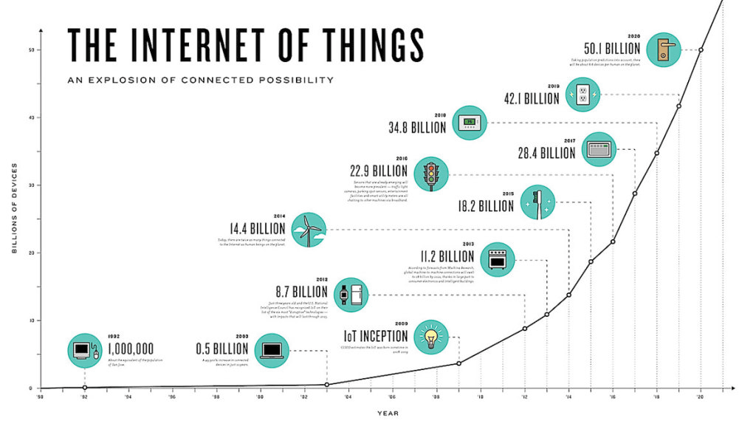

Internet of Things
Source: https://gigazine.net/gsc_news/en/20170412-iot-market-2023

Slide 6
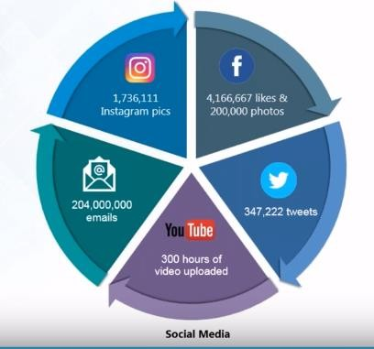
Social Media
Source: Edureka

Slide 7
Other Factors
Retail
Customer Transactions (Walmart handles more than 1 million
customer transactions every hour)
Search history details
Banking and Finance
Healthcare
Research Activities (Decoding the human genome)

Slide 8
CERN’s Large Hydron Collider (LHC) generates 15 PB a year
Maximilien Brice, © CERN

Slide 9
What is Big Data?

Slide 10

What is Big Data?
As per Wikipedia
“Big data is a term for data sets that are so large or complex that traditional data processing applications are inadequate to deal with them.”

Slide 11
5V’s of Big Data

Slide 12


5V’s of Big Data
Volume
Data quantity
Velocity
Data Speed
Variety
Data Types
Value
Meaningful Insights
Veracity
Quality of Data

Slide 13
Volume
Volume refers to the total amount of data.
Today, Facebook ingests 500 terabytes of new data every day.
Boeing 737 will generate 240 terabytes of flight data during a single flight across the US.
The smart phones, the data they create and consume; sensors embedded into everyday objects will soon result in billions of new, constantly-updated data feeds containing environmental, location, and other information.

Slide 14
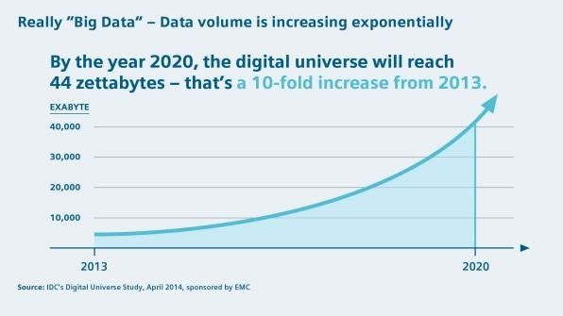
Volume

Slide 15
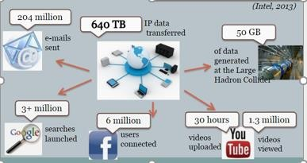
Velocity: Measure of how fast the data is coming in.
Data generated in one minute in the digital world

Slide 16
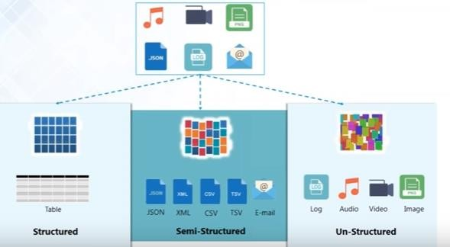
Variety

Slide 17
Variety
Structured Data
Data which can be stored in database in table with rows and columns.
Have relational key and can be easily mapped into pre-designed fields.
Eg. Relational Database
Semi Structured Data
Partially organised data
XML, CSV files
Unstructured Data
Data that cannot be organized in a pre-defined manner.
Eg. Email messages , Audio files, Video files
Represent around 80% of data.
Growing quickest than others, and their exploitation could help in business decision

Slide 18
Veracity
Veracity is the quality or trustworthiness of the data.
Is the Data collected from Twitter posts with hash tags, abbreviations, typos, etc., reliable and accurate?
Do you trust the data that you have collected?
Is this data credible enough to collect insights from?
Should we be basing our business decisions on the insights gathered from this data?
When processing big data sets, it is important that the validity of the data is
checked before proceeding for processing.

Slide 19

Value
Refers to worth of the data being extracted.
The bulk of Data having no Value is not at all useful for the company.
Data needs to be converted into something valuable to achieve business gains.
By calculating the total cost of processing big data and comparing it with the ROI that the business insights are expected to generate, companies can effectively decide whether or not big data analytics will actually add any value to their business.

Slide 20



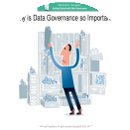

Challenges with Big Data
Storing exponentially growing huge data sets
Integrating disparate data sources Generating insights in a timely manner
Data Governance Security Issues

Slide 21
What is Big Data Analytics?
Examining large and different types of data to uncover hidden patterns, correlations and other insights.

Slide 22
Big Data Analytics Use Cases

Slide 23
Amazon’s “360-degree view”
Amazon uses Big Data gathered from customers to build and fine-tune its recommendation engine.
what you buy
your reviews/feedback
any personal details
your shipping address (to guess your income level based on where you live)
Browsing behavior
The more Amazon knows about you, the better it can predict what you want to buy.
May make recommendations based on what other customers with similar profile bought.
Also helps in retaining their customers

Slide 24
Amazon –Improving user experience
Analysing the clicks of every visitor on their website aids them in
understanding their site-navigation behaviour
paths the user took to buy the product
paths that led them to leave the site and more
All this information helps Amazon to improve user experience, thereby
improving their sales and marketing.

Slide 25
Social Media Analysis and Response
Companies monitor what people are saying about their products or services in social media
Collect and analyze the posts on Facebook, Twitter, Instagram etc.
Helps in improving their products
Improve Customer Satisfaction Retaining customers

Slide 26
IIoT - Preventive Maintenance and Support
Factories and other facilities that use expensive equipment are deploying sensors
to monitor that equipment and transmit relevant data over the Internet.
Big data solutions analyze that information — often in real time — to detect when a problem is about to occur.
Perform preventive maintenance that may help prevent accidents or costly line
shutdowns.

Slide 27
Healthcare
Big Data in healthcare pertains to the massive amounts of healthcare data gathered from multiple sources such as
wearable devices like fitness trackers, smartwatches, sensors, etc.
Biometric data such as X-Rays images, MRI scans
medical documents
EHR (electronic health records) which includes demographics, medical history, allergies, laboratory test results etc.
Helps doctors or medical specialists create databases.
Vital for the prediction of inherited diseases. For instance, the patients at risk of developing a specific disease (e.g. diabetes) can benefit from preventive care.
May make suggestions for each patient according to the information collected from other human beings.

Slide 28
Healthcare (Contd..)
In hospitals, Clinical Decision Support (CDS) software analyzes medical data on the spot, providing health practitioners with advice as they diagnose patients and write prescriptions.
Real-Time Alerting
Wearables collect patients’ health data continuously and provide doctors with information and changes.
if something is wrong, an alert will be automatically sent to the doctor or another specialist.
doctor is able to contact the patients without further delay and give them all the necessary instructions.

Slide 29
Insurance Fraud
Insurers analyze their internal data to gain insight into potentially fraudulent claims, such as
call center notes and voice recordings,
social media data
third party details on people’s bills, wages, bankruptcies, criminal records, and address changes
For example, while a claimant may declare their car was damaged by flooding, their social media feed may indicate weather conditions were sunny on the day of the supposed incident.
Insurers can supplement this data with text analytics technology that can detect minor discrepancies hidden in a claimant’s case report.
Fraudsters tend to alter their story over time, making this a powerful tool in detecting criminal activity.

Slide 30
Big Data as a Boon
Efficient utilization of big data is the key to business growth
Cost Savings
Faster and Better Decision Making Understand the market conditions Next Generation products
Evaluation of customer satisfaction

Slide 31
Big Data Analytics Tools

Slide 32
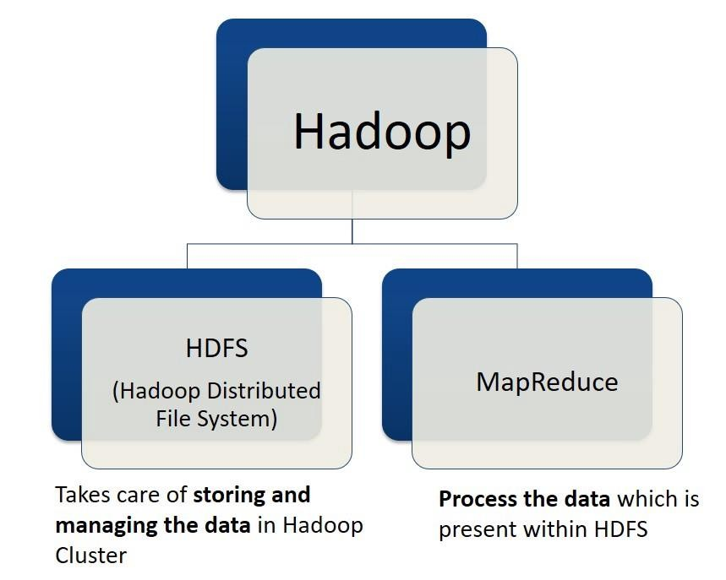
Apache Hadoop
Hadoop is an open source software built to handle very large data sets.

Slide 33
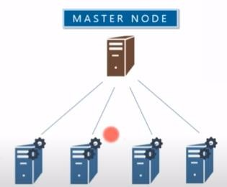
HDFS
NameNode
HDFS is the storage component of Hadoop.
Stores data by splitting files into blocks of pre-determined size
Blocks are stored across a cluster of nodes
Follows a Master/Slave Architecture, where a cluster comprises of a single
DataNodes
NameNode (Master node) and all the other nodes are DataNodes (Slave nodes).

Slide 34

HDFS Core Components
NameNode
Secondary NameNode
DataNode
DataNode
DataNode

Slide 35
NameNode
Master node in the HDFS Architecture
Maintains and manages the blocks present on the DataNodes
highly available server that controls access to files by clients.
records the metadata of all the files stored in the cluster, e.g. location of blocks stored, size of files etc.
Metadata is maintained using two files:
FsImage: contains all the modifications ever made across the Hadoop Cluster since the start of the NameNode (stored on disk).
EditLogs: contains all the recent modifications made – may be in last 1 hr (stored in RAM).

Slide 36
NameNode
responsible to take care of the replication factor
receives a Heartbeat (default 3 sec) and a block report from all the DataNodes to ensure DataNodes are live
Responsible for choosing new DataNodes in case of DataNode failure

Slide 37
DataNodes
slave nodes in HDFS
Stores actual data
commodity hardware - non-expensive system which is not of high quality or high-availability
Serve read and write requests from clients

Slide 38
Secondary NameNode
Secondary NameNode works concurrently with the primary NameNode as a helper daemon
Responsible for performing checkpointing.
combining the EditLogs with FsImage from the NameNode.
downloads the EditLogs from the NameNode at regular intervals and applies to FsImage.
The new FsImage is copied back to the NameNode, which is used whenever the NameNode is started the next time.
Performs regular checkpoints (deafault 1 hr) and hence also called as CheckpointNode.
During checkpointing, latest changes are stored on new EditLogs file

Slide 39

Secondary NameNode and Checkpointing

Slide 40

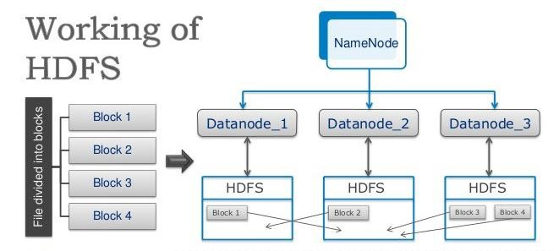
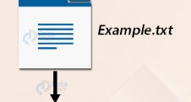
HDFS Data Blocks
406 MB
Block1 128 MB | Block 2 128 MB | Block 3 128 MB | Block 4 22 MB

Slide 41
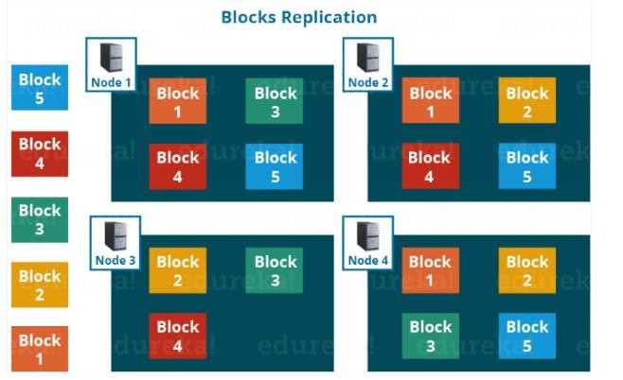
Replication Management
HDFS provides reliability by replicating blocks to different nodes.
The default replication factor is 3 which is configurable.

Slide 42
MapReduce
MapReduce is the processing engine of Hadoop.
Hadoop processes data by delivering code to nodes to process in parallel.
Map function transforms the piece of data into key-value pairs
Then the keys are sorted where a reduce function is applied to merge the values based on the key into a single output.

Slide 43
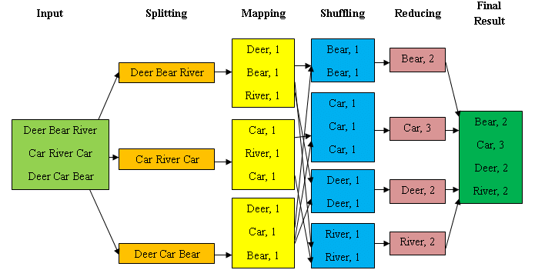
Working of MapReduce

Slide 44
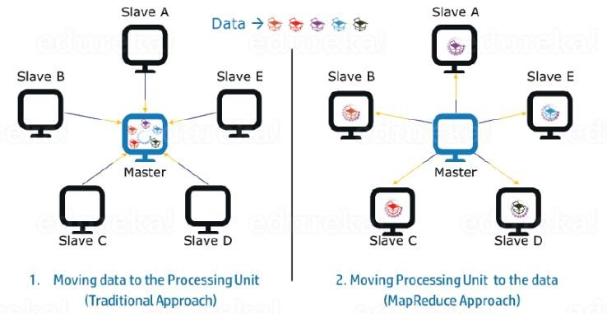
MapReduce - Parallel Processing
Job is divided among multiple nodes and each node works with a part of the job simultaneously.
As the data is processed by multiple machines instead of a single machine in parallel, the time taken to process the data gets reduced by a tremendous amount.

Slide 45
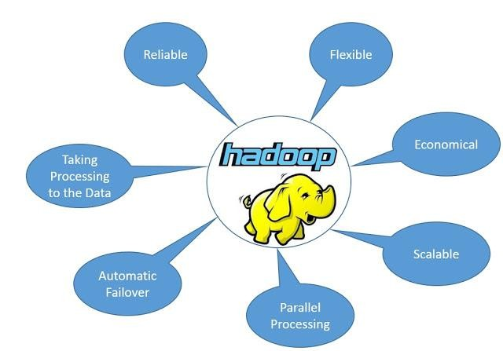
Benefits

Slide 46
Big data analytics tools
Hive
Hive was designed to automatically translate SQL-like queries into MapReduce jobs on Hadoop—all through the
use of a language called HiveQL.
Spark
Spark is frequently used as an alternate to Hadoop’s MapReduce because it it is able to analyze data up to 100 times faster for certain applications.
Common use cases for Apache Spark include streaming
data, machine learning and interactive analysis.

Slide 47
Big data analytics tools
NoSQL databases
RDBMS could no longer meet new data management needs of
Big Data.
Not Only SQL (NoSQL) allows storing, retrieving and analyzing massively large volumes of disparate and complex data at lightning fast speeds.

